Slide 1

TOP YOUTUBE CHANNELS AND VIEWS ANALYSIS
K.Beaula sharon - 22091A3212
J.Chandhana - 22091A3216
N.Gowthami - 22091A3225
S.Hyndavi - 22091A3240
D.Indu mahela - 22091A3243

Slide 2
CONTENTS
Abstract
Introduction
System Requirements
Architecture
Uses of data analysis library
Advantages
Conclusion

Slide 3
ABSTRACT
This project presents a comprehensive data analysis of the top YouTube channels based on their total views, subscriber counts, video uploads, and content categories.
YouTube, being the world’s largest video-sharing platform, offers vast insights into audience preferences, content trends, and creator performance.
The objective of this study is to understand what drives viewership and popularity on YouTube by examining metrics such as average views per video, growth trends by category (e.g., Music, Gaming, Education), and the geographical distribution of top-performing channels.
Visualizations help highlight the dominance of certain categories, the rise of regional content creators, and the relationship between content volume and audience reach.

Slide 4
INTRODUCTION
YouTube is the world’s largest video-sharing platform, hosting billions of videos and users worldwide.
It plays a crucial role in digital content creation, marketing, education, and entertainment.
Analyzing top YouTube channels helps uncover trends in content popularity, audience behavior, and creator performance.
This project focuses on data analysis of over 1000 top YouTube channels using Python-based tools.
The dataset includes information like channel name, category, country, total views, subscriber count, and number of uploads.
The goal is to identify which categories perform best, which countries lead in content creation, and how viewership correlates with uploads.

Slide 5
SYSTEM REQUIREMENTS
Software Requirements:
OPERATING SYSTEM:
The analysis can be performed on Windows .
Python
Python 3.x is required for running the analysis.
Libraries:
Pandas – for data handling
Scikit-learn – for machine learning models
Matplotlib / seaborn – data visualization

Slide 6
Hardware Requirements
IDE – Jupyter Notebook
Storage Space – free storage space enough for running on machine
RAM – Minimum 4 GB (8 GB recommended for smoother performance)

Slide 7
ARCHITECTURE
The process typically includes data acquisition, data preprocessing, data visualization.
Let's explore the architecture in more detail:
Data collection
Importing libraries
Loading data
Data exploration
Data visualization
Training the model

Slide 8
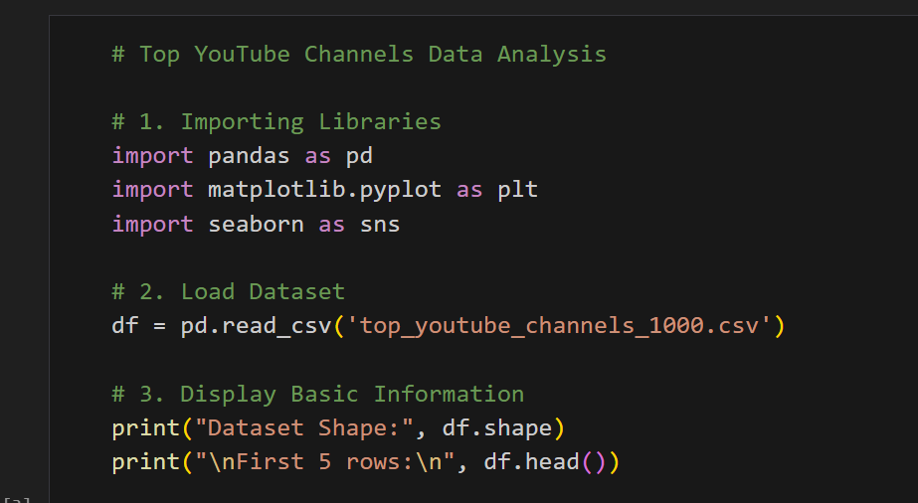
IMPORTING DATASET
Importing a dataset means loading external data (usually stored in files like CSV, Excel, JSON, etc.) into your program or environment, so it can be used for analysis, processing, and training models.

Slide 9
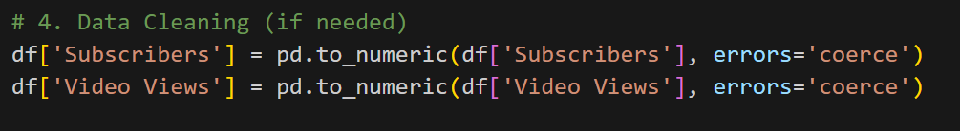

Data cleaning and analysis
Data cleaning is the process of detecting and correcting (or removing) corrupt, inaccurate, inconsistent, missing, or duplicate data within your dataset—transforming raw data into a reliable form for analysis and modeling

Slide 10

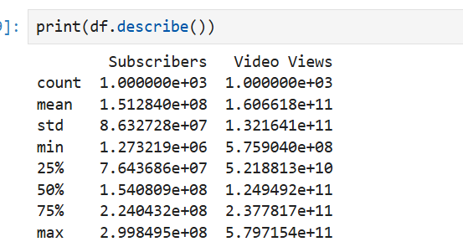
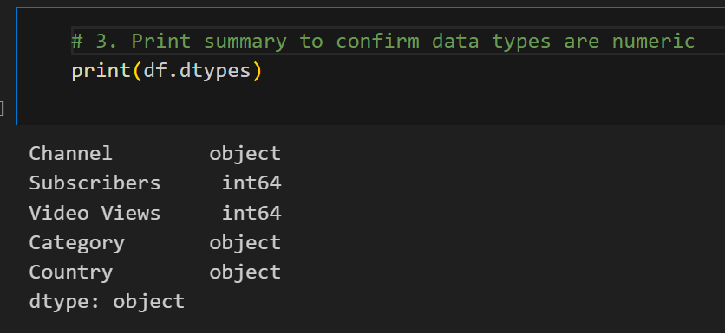

Slide 11
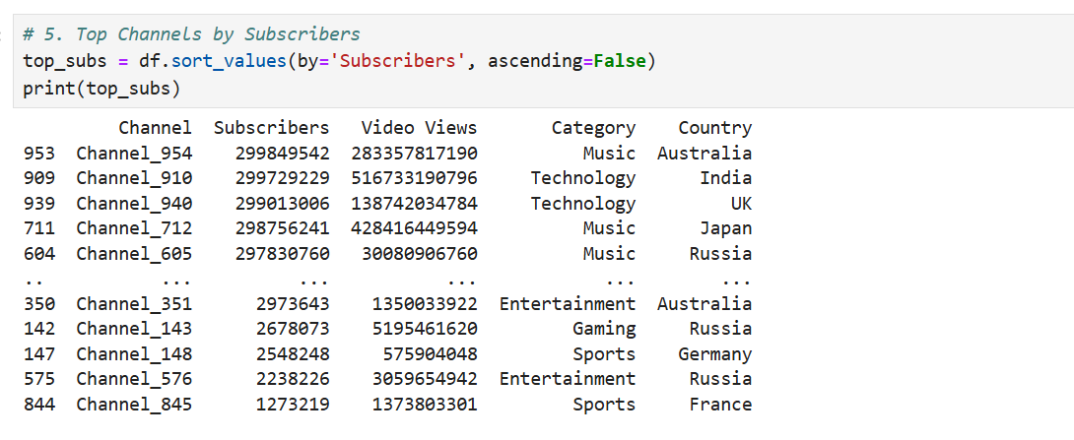

Slide 12

DATA EXPLORATION:
Data Exploration is the process of examining and understanding the main characteristics of a dataset using summary statistics and visualization tools before performing any modeling or analysis

Slide 13
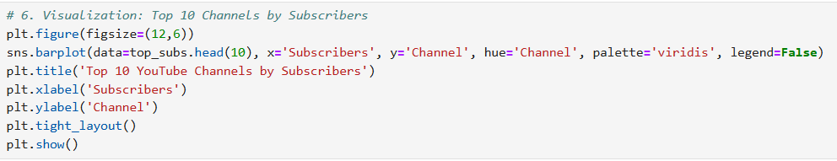
Data visualization
Data Visualization is the graphical representation of information and data using visual elements like charts, graphs, and maps. It helps make complex data more accessible, understandable, and usable

Slide 14
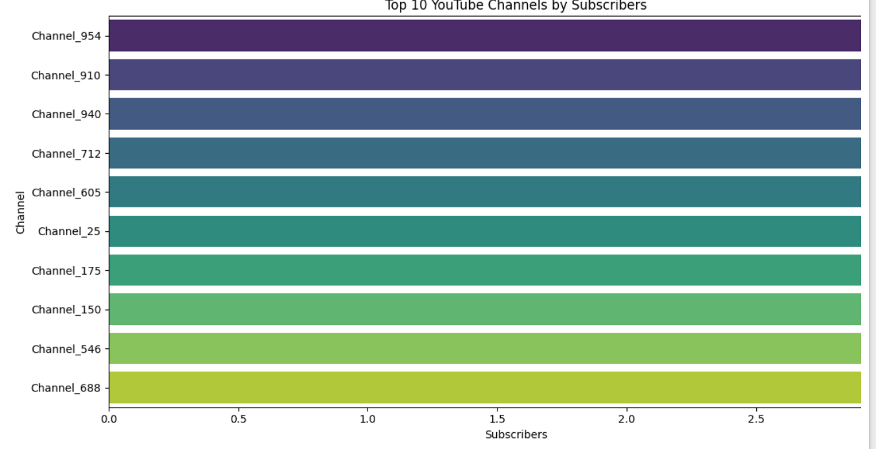

Slide 15
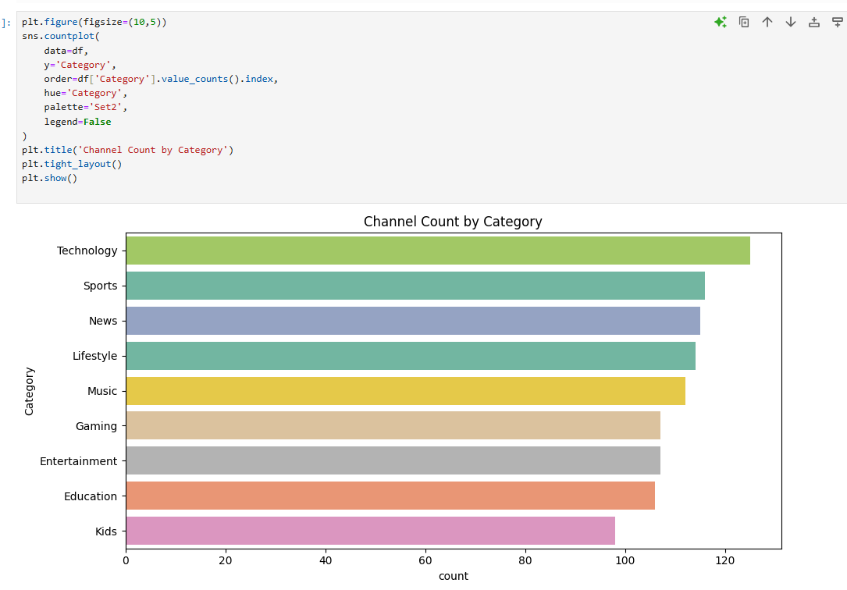

Slide 16
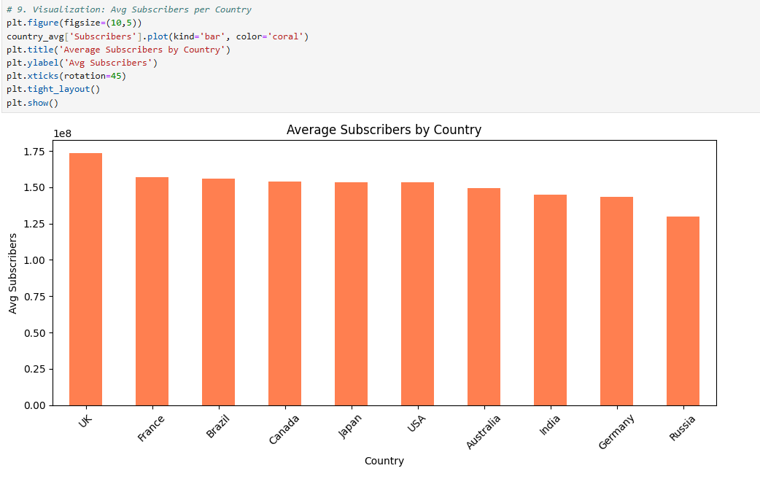

Slide 17
USES OF DATA ANALYSIS LIBRARY
1. Pandas
Used for loading and handling the SMS dataset (CSV or text format).
Allows easy data cleaning, manipulation, and exploration (e.g., checking for missing values, labeling columns).
2. NumPy
Provides support for numerical operations such as array handling.
used internally in many ML and NLP processes for fast computation.
3. Matplotlib & Seaborn
Used for data visualization to understand class distributions (e.g., number of spam vs. ham messages).
Helpful in plotting word frequencies, correlation graphs, or model performance (accuracy/loss curves).

Slide 18
ADVANTAGES
Data-Driven Decision Making :Helps understand what content types are most successful on YouTube using real-world data.
Visual Insight: Use of clear and interactive visualizations makes trends easy to understand and present.
Global Perspective Analyzes :Data across multiple countries, offering insights into international content trends.
Skill Enhancement: Strengthens data analysis, visualization, and Python programming skills.
Scalable and Reusable Framework :The project structure can be adapted for other social media platforms or datasets with minimal changes

Slide 19
CONCLUSION
Here is the Conclusion for your Top YouTube Channels and Views Analysis project:The analysis of top YouTube channels provides meaningful insights into the dynamics of digital content creation and audience engagement. By examining key metrics such as views, subscribers, uploads, categories, and geographic distribution, we can identify what drives success on YouTube .
The results show that categories like Music, Gaming, and Entertainment dominate in terms of total views and subscribers. Countries such as India and the United States emerge as major contributors to top content, reflecting regional preferences and global reach.

Slide 20
Thank you

